Slide 1
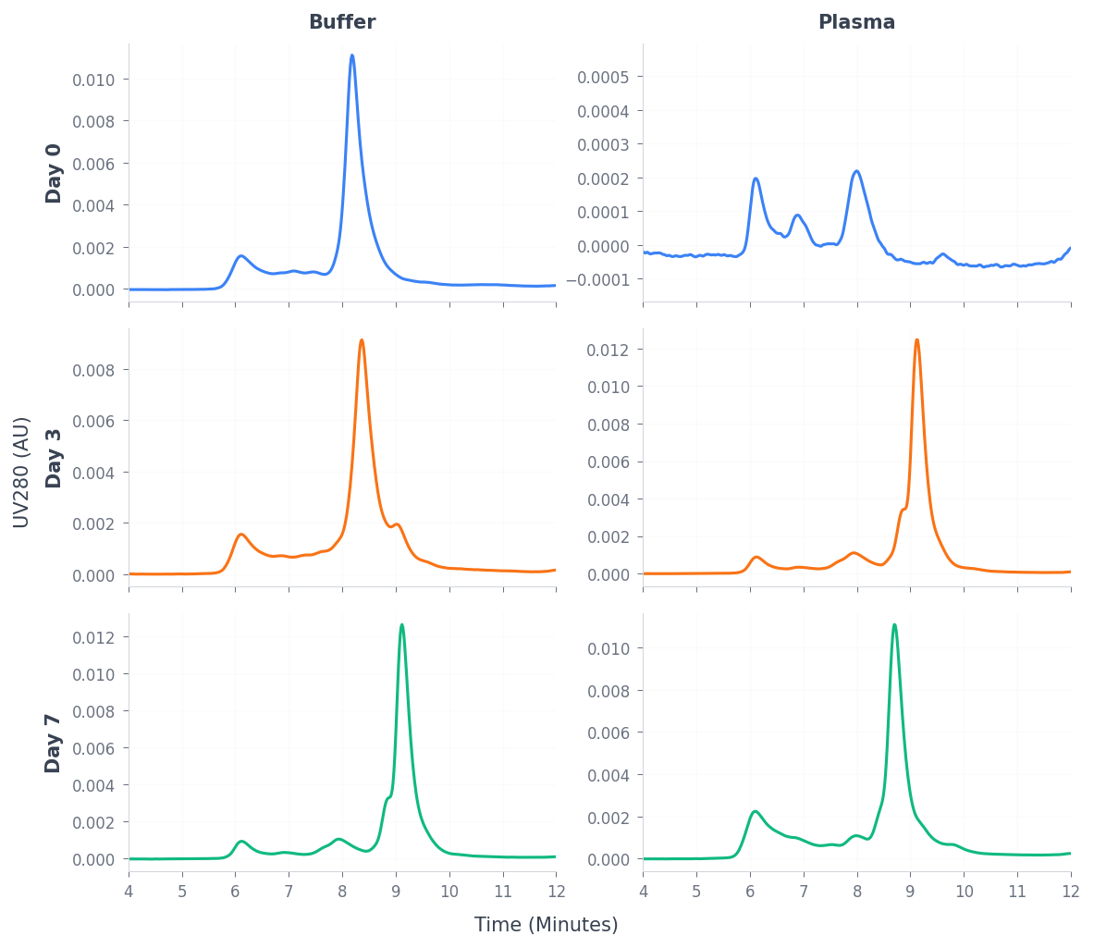
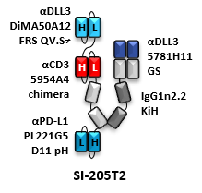
SI-205T2
Monomer % by SEC
Matrix | D0 | D3 | D7
Buffer | 73.5% | 63.0% | 8.1%
Plasma | 96.6% | 8.6% | 5.9%

